Slide 1
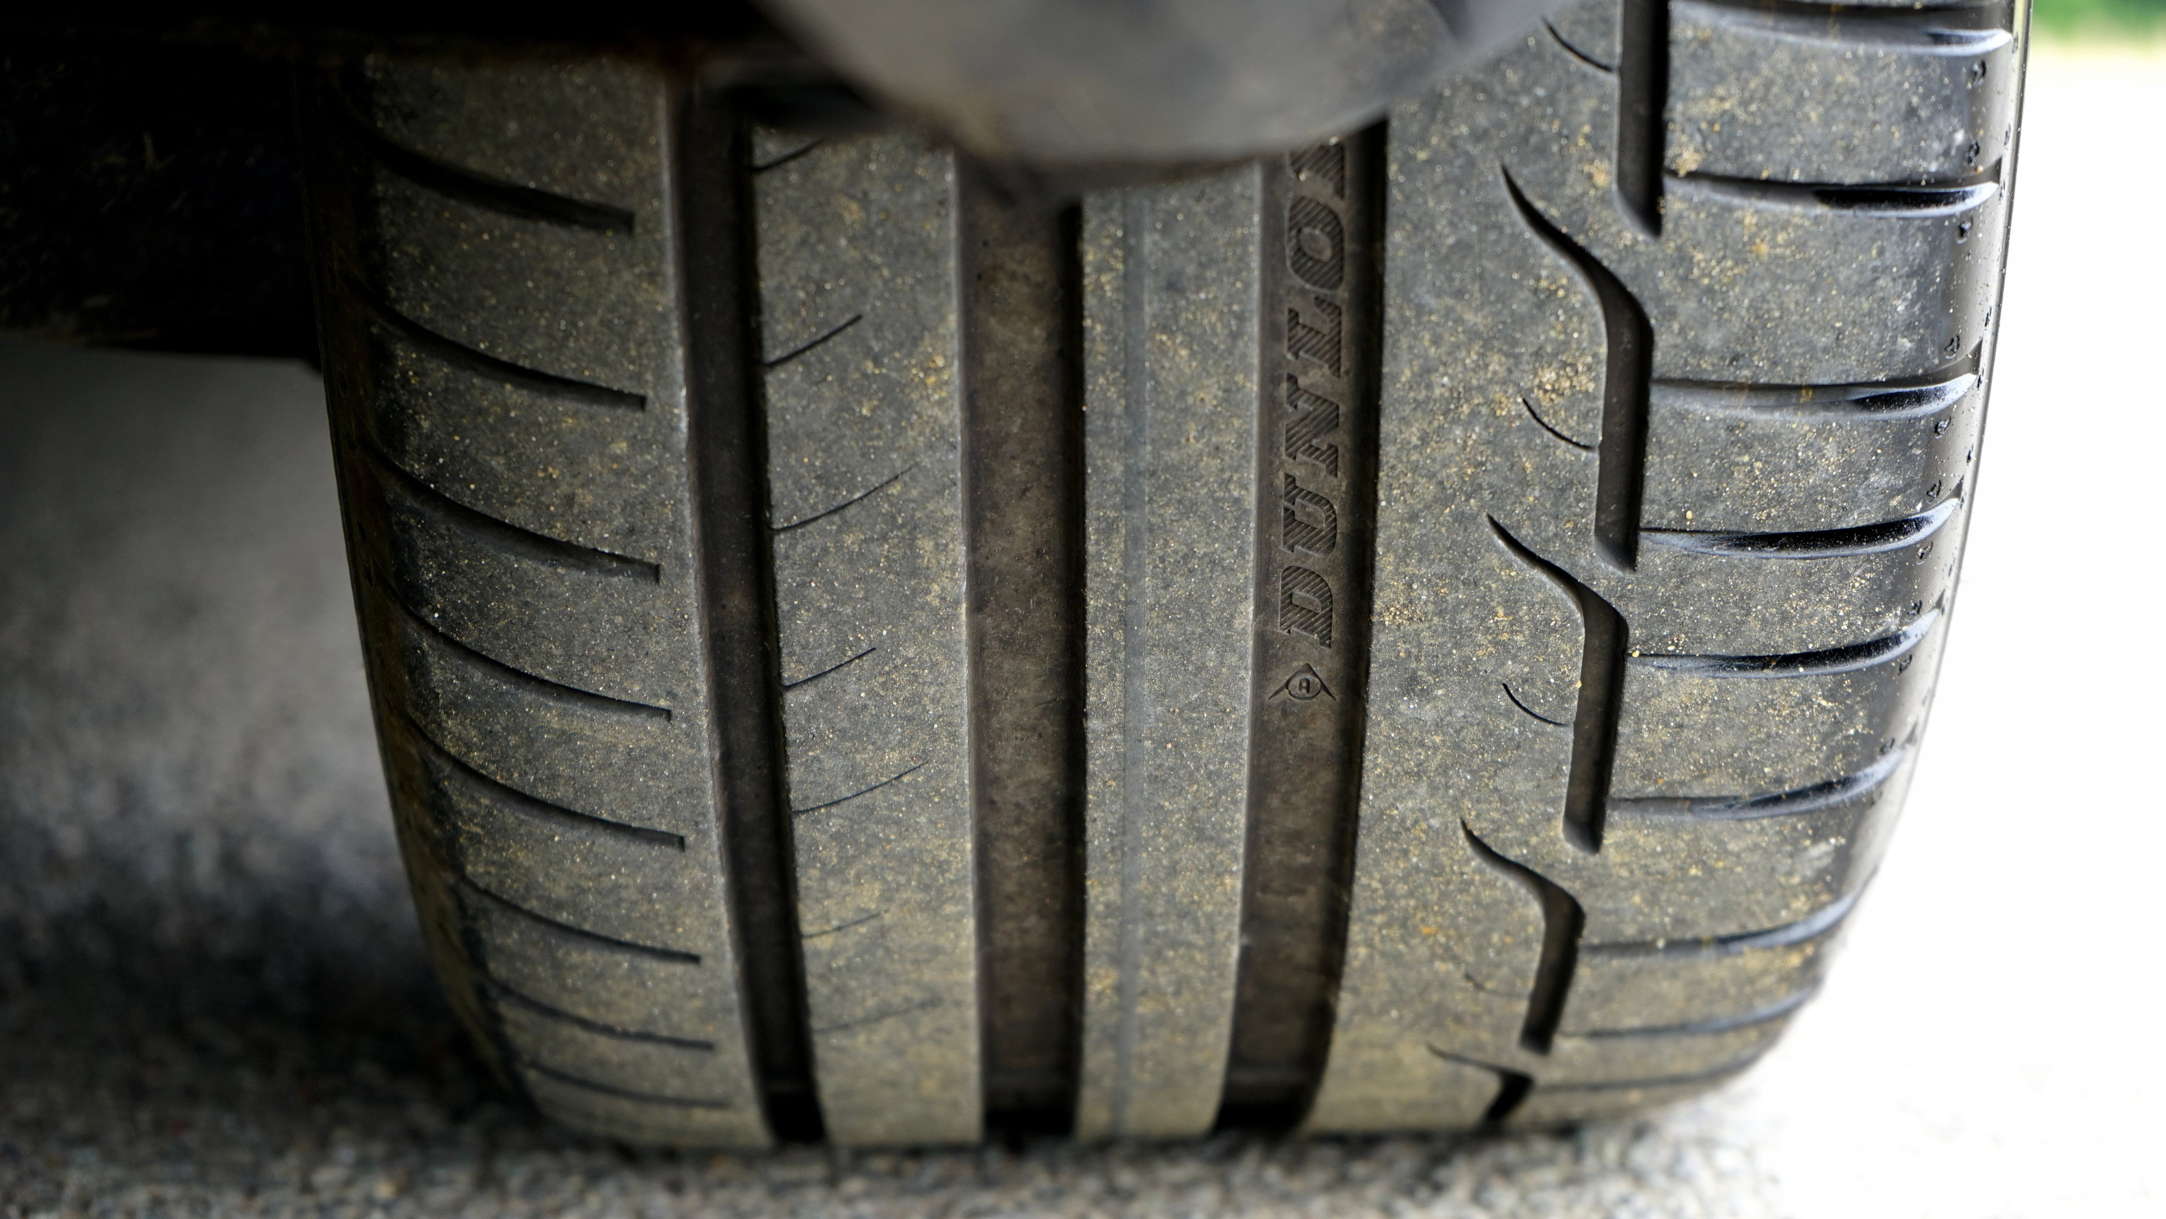
TIRES ON HIGHWAY
Developing an AI-Driven Model to
Assess Tire Condition through Toll
Plaza Images.

Slide 2
AGENDA
INTRODUCTION
PLAN FOR PROJECT
TECH ARCHITECTURE
WEB INTERFACES

Slide 3
Project Management Infographics
Laying The Foundation
AI/ML Model
Designing the architecture,selecting technology stack,and creating a roadmap for development.
Analyzes images to provide feedback on tire condiction.
PLAN FOR PROJECT
Project Execution
Deployment.
Web Apps
The setup of the TiresOnHighway web apps.
Project Monitoring and controlling and completing
Ensure project runs smoothly without any issues

Slide 4
Technology Stacks
Frontend
Backend
Database
ML Model
MongoDB
Express.js
Node.js
Flask
CNN(convolutional neural network)
React
Bootstrap
HTML
CSS JS

Slide 5
Interfaces Involved
USER INTERFACE
WEB APP
Report of the tire and details of vechile
TOLL PLAZA INTERFACE
Uploading Photos
TIRE DEALER INTERFACE
List of records generated by model

Slide 6
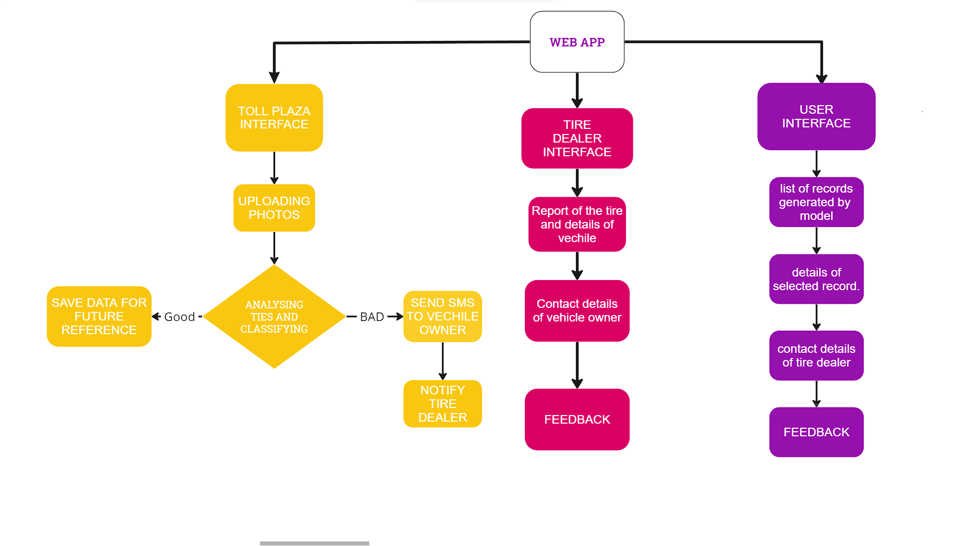
WEB APP INTERFACE FLOWCHART

Slide 7
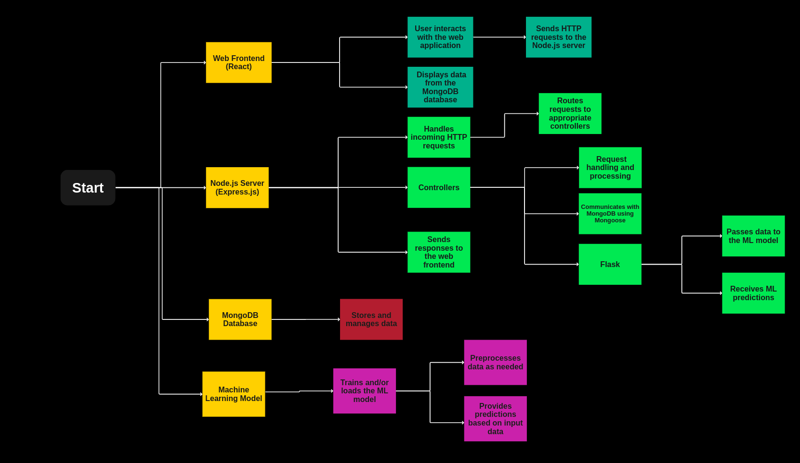
TECH ARCHITECTURE

Slide 8
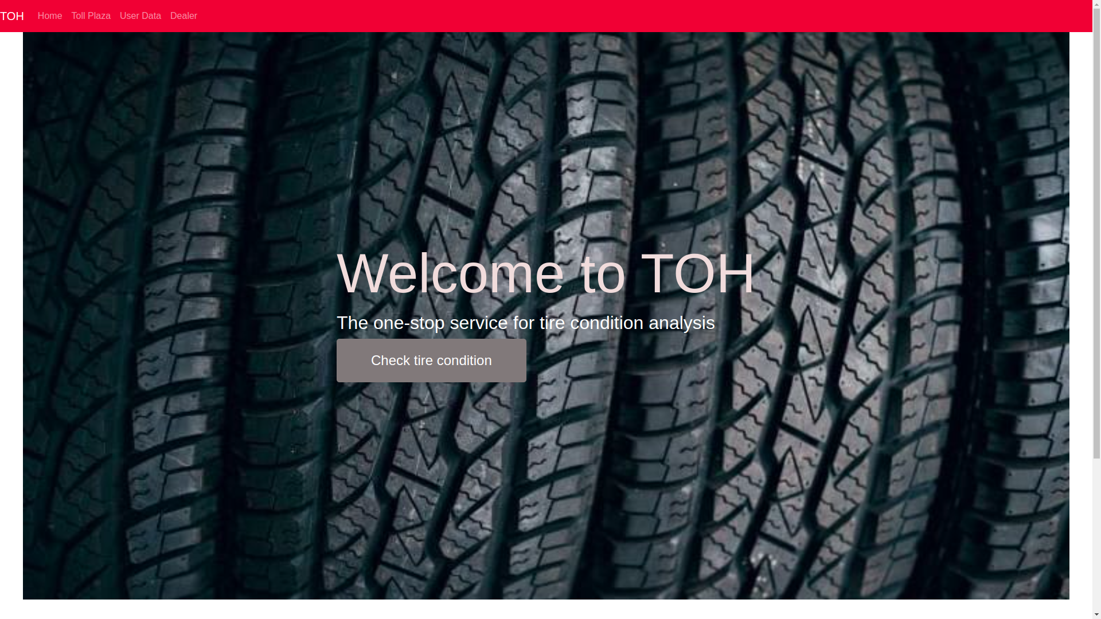
INTERFACE

Slide 9
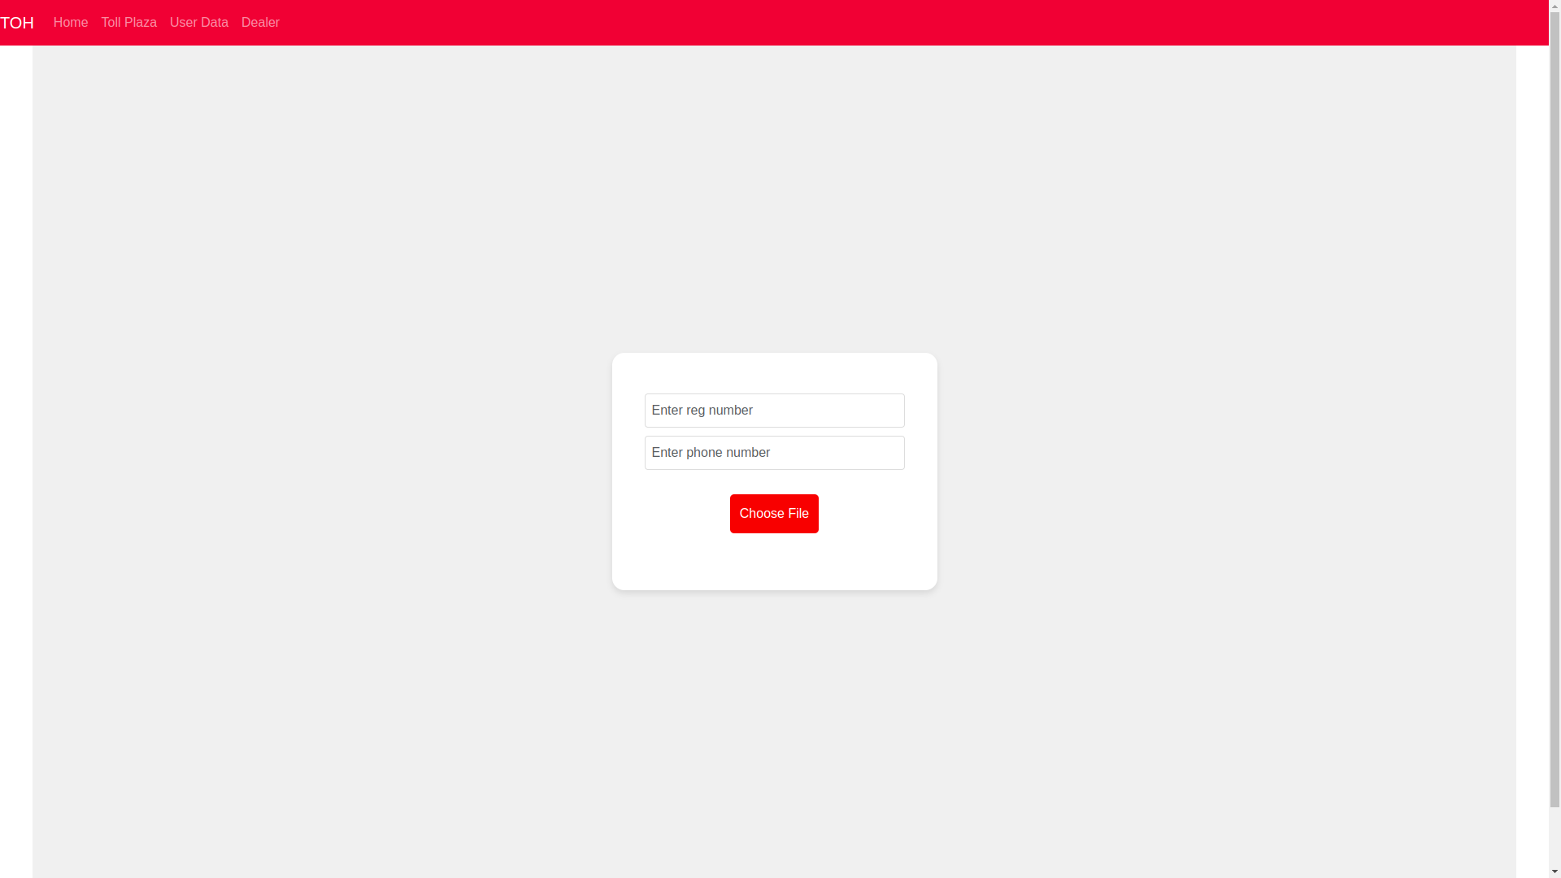

Slide 10
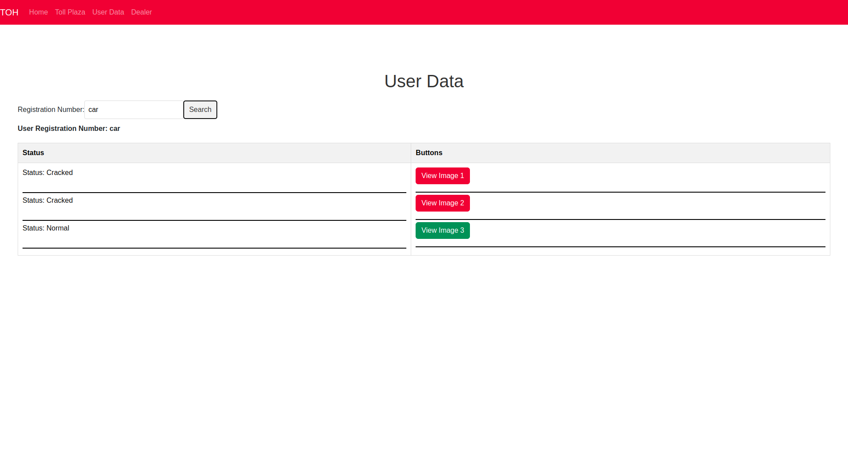

Slide 11
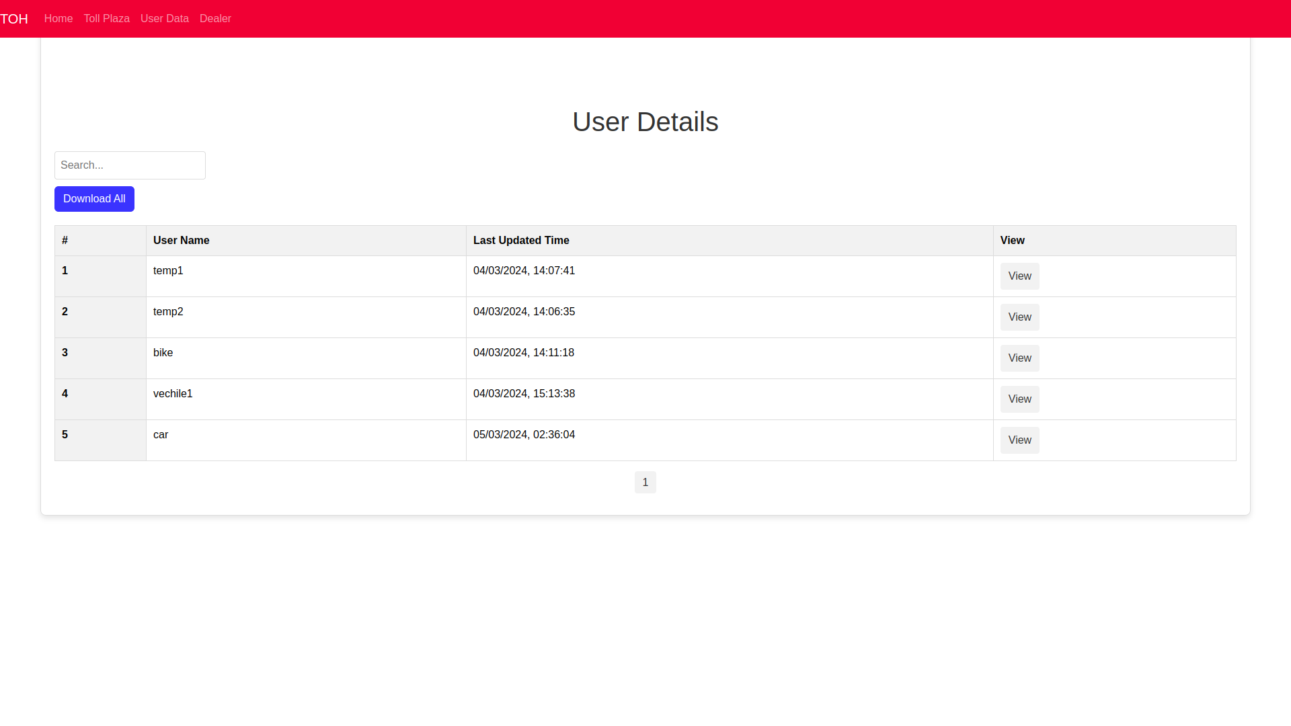

Slide 12
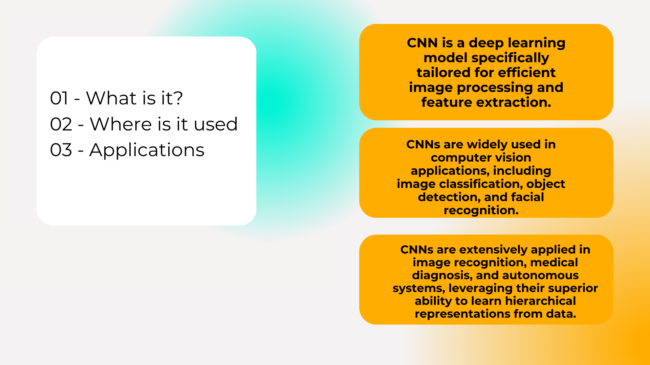

Slide 13
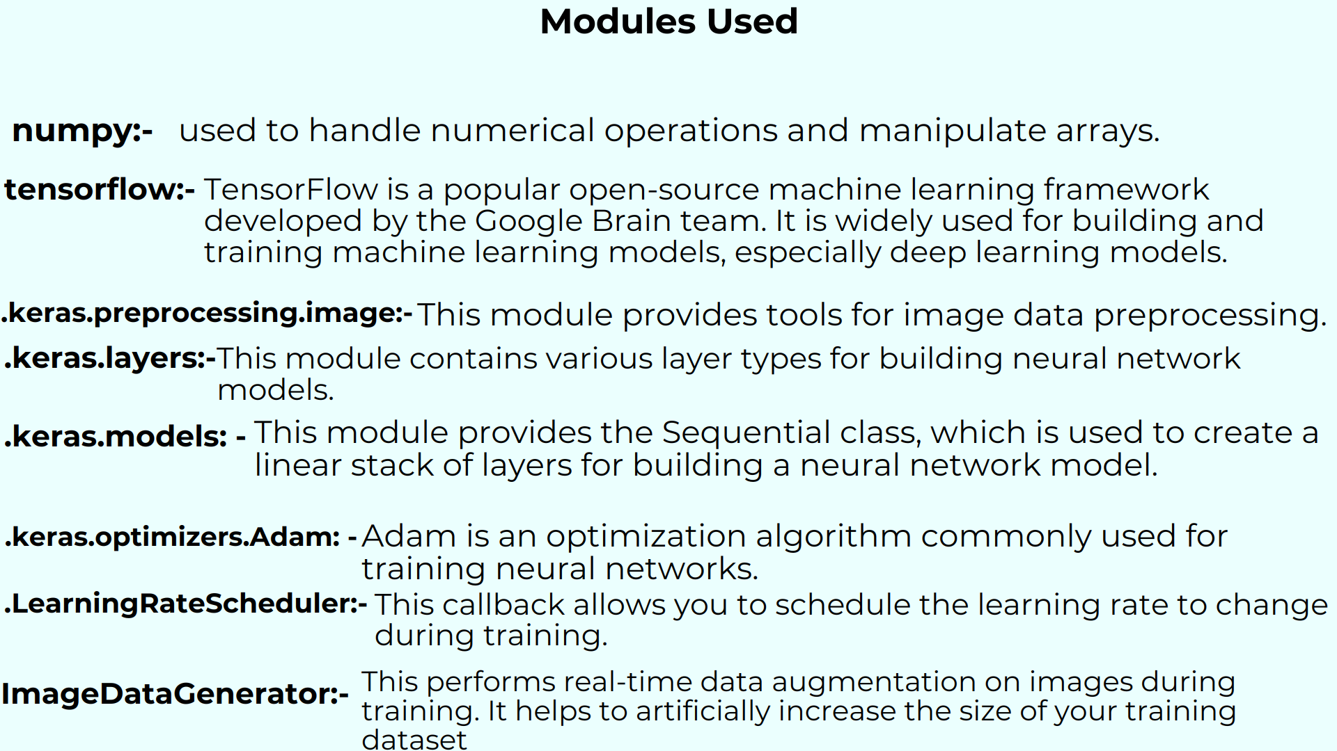

Slide 14
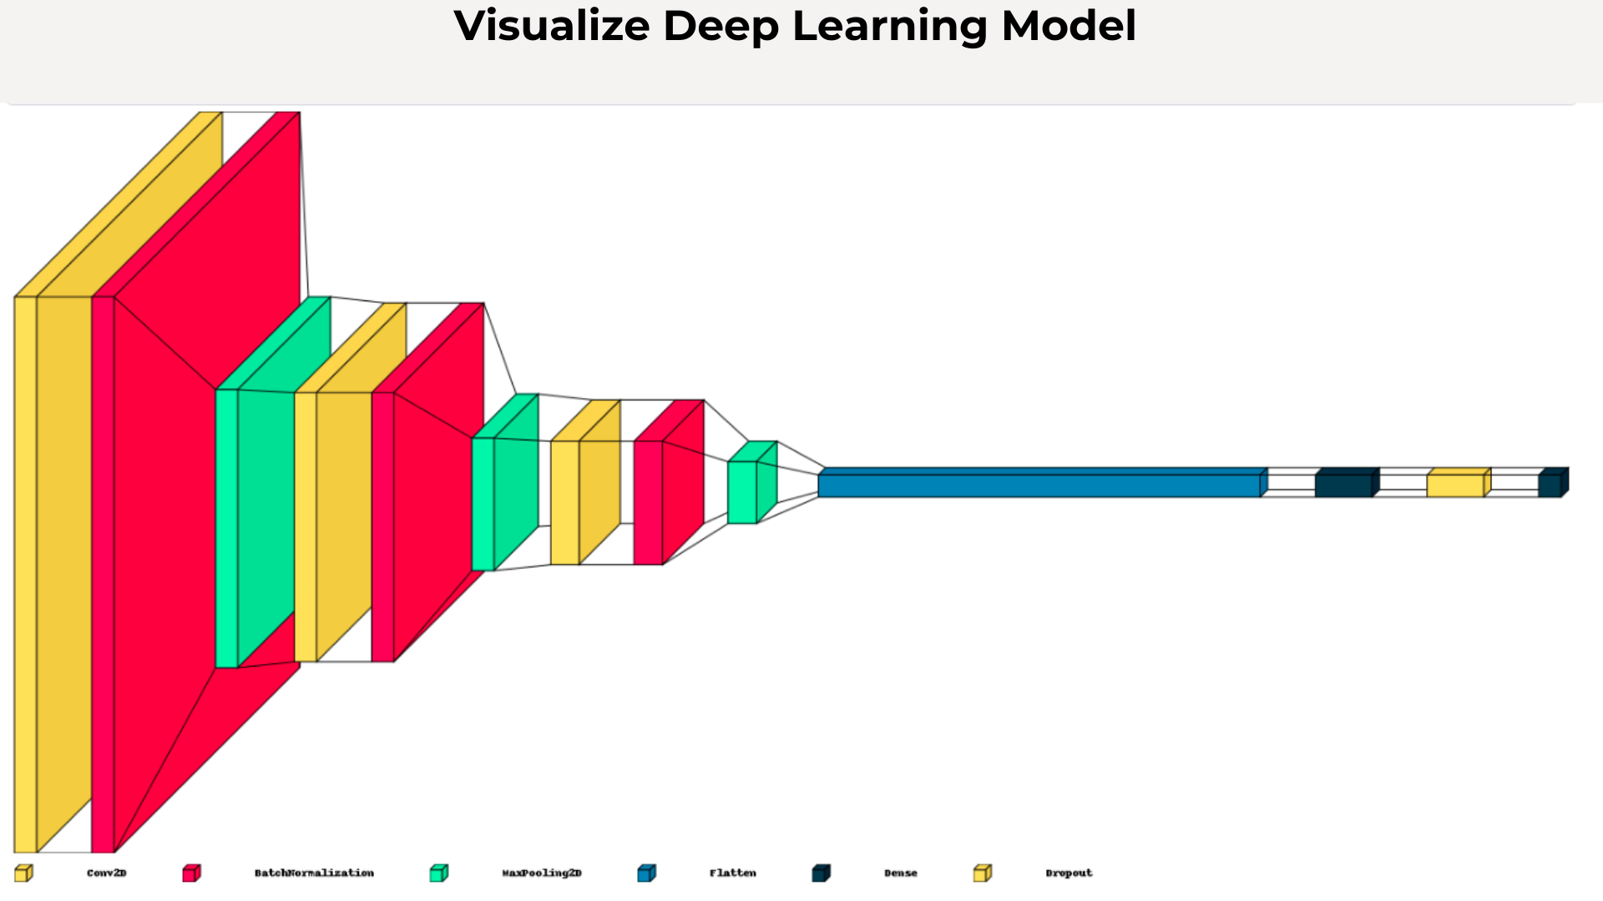

Slide 15
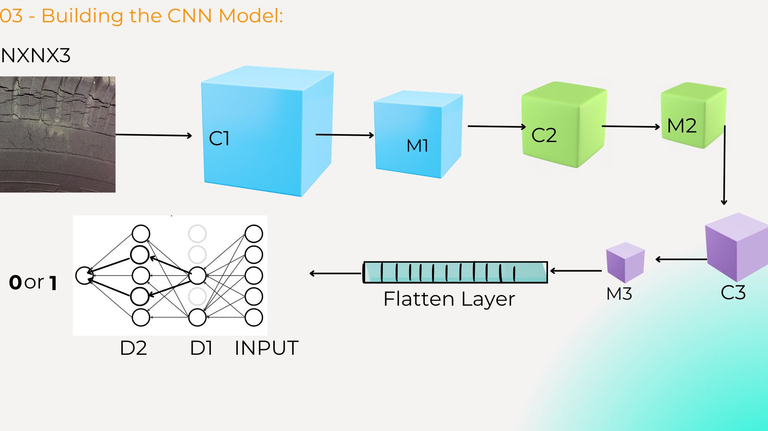

Slide 16
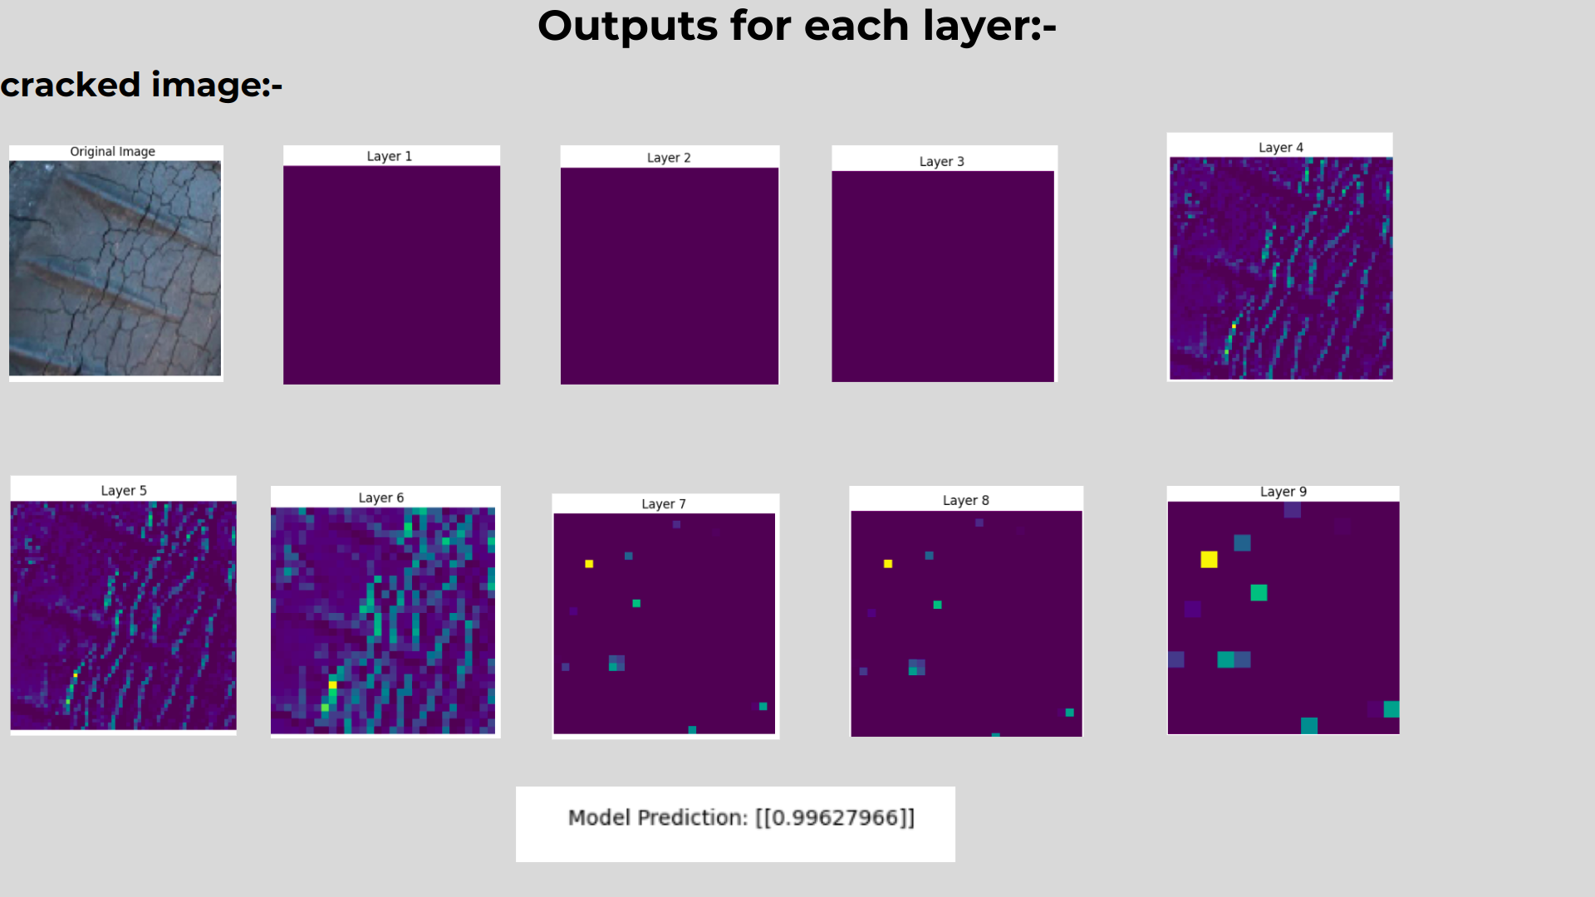

Slide 17
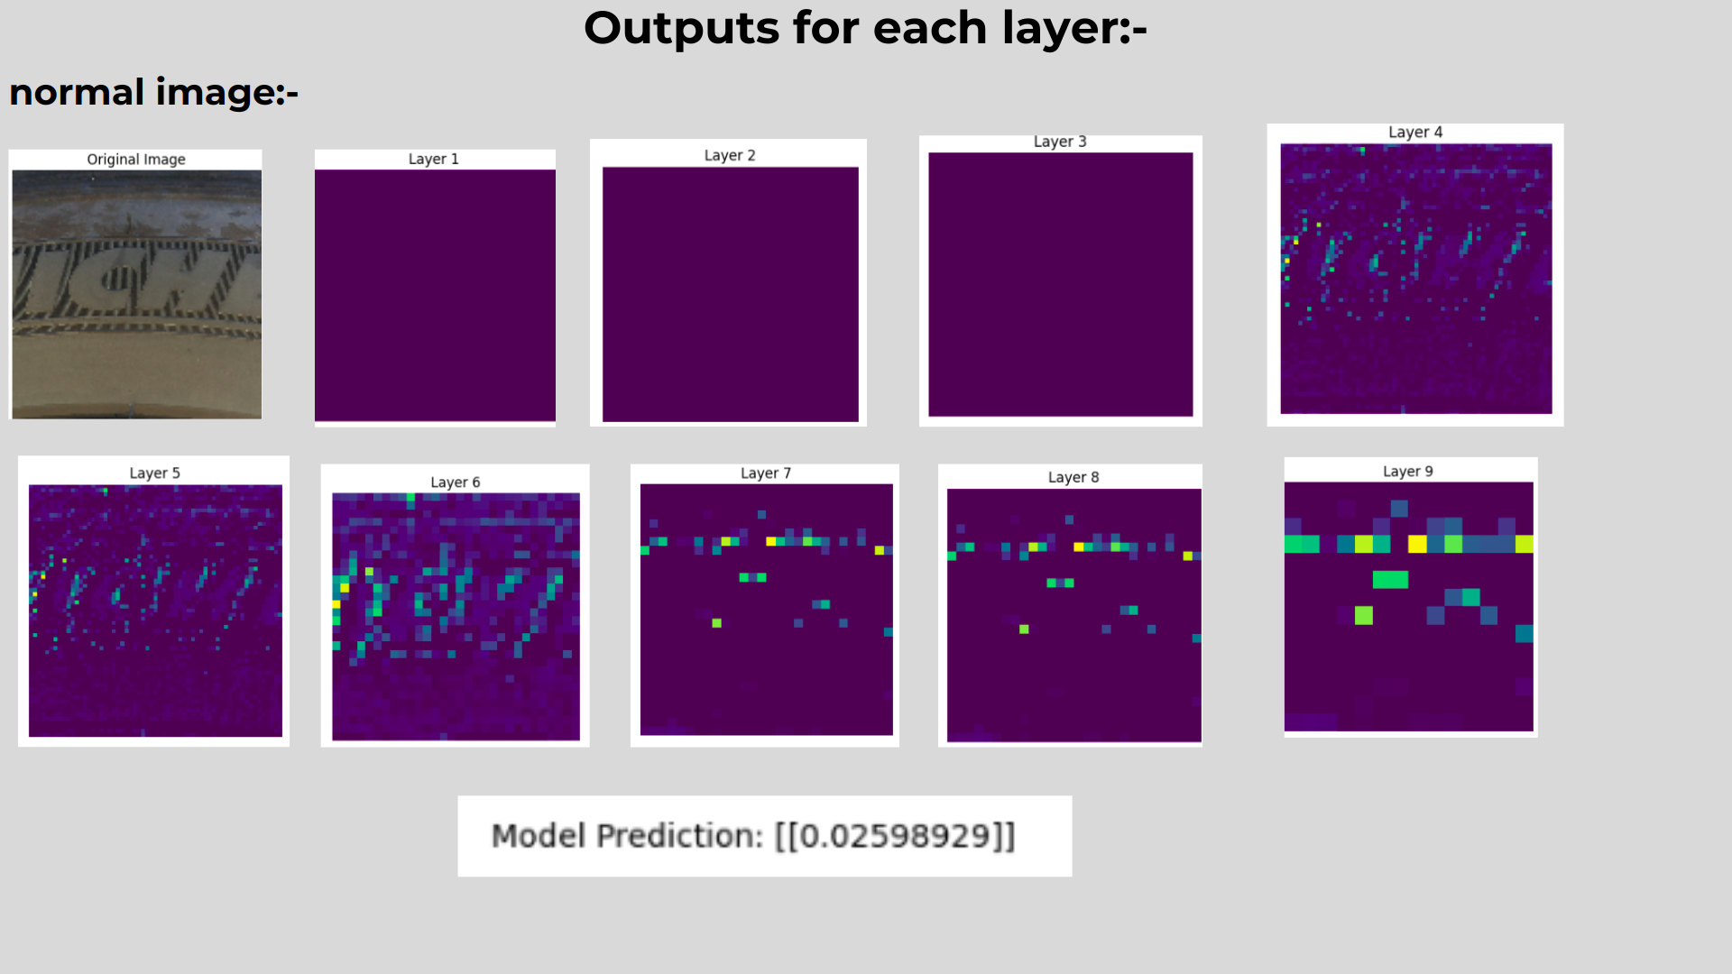

Slide 18
